Slide 1





ANALYSIS OF CALIFORNIA HOUSING MARKET
BY
Karthik Kovuri (MSBA)
PROFESSOR : JIN FANG

Slide 2


RESEARCH PROBLEM
California is typified by an expensive housing market with regional discrepancies and a changing demographic impact. The socioeconomic and geographic factors that are going to define house prices include median income, house age, and location. Detailed insight into these would be helpful for the policymakers, developers, and residents in their decision-making process.
The analysis focuses on median income, house age, geographic location, and other socioeconomic variables to determine their impact on housing prices (Target).

Slide 3





OBJECTIVES AND METHODOLOGY
Analyze Correlations
Study relationships between variables to identify key factors influencing housing prices.
Impact of Median Income
Quantify the relationship between median income and housing price through linear regression.
Predictive Model
Develop a multiple regression model using subset selection
to predict housing prices accurately.
Geographic Influences
Analyze how geographic factors such as latitude and longitude influence housing prices.

Slide 4

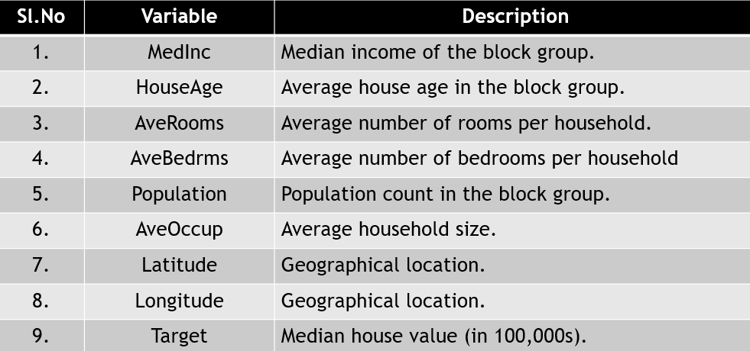

DATA OVERVIEW
The dataset includes 9 variables across 20,640 records, covering the following aspects:

Slide 5
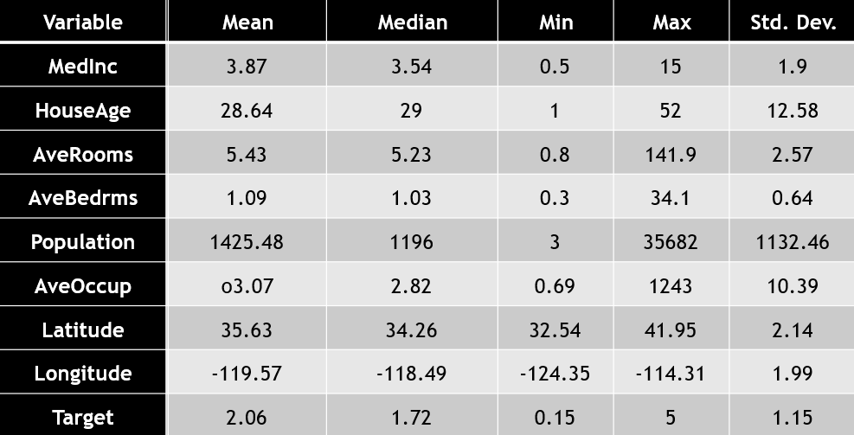
DESCRIPTIVE STATISTICS

Slide 6



SOFTWARE USED
01
RStudio:
•Perform data analysis, visualization, and statistical modeling.
Key Packages:
•ggplot2: For creating scatter plots, heatmaps, and other visualizations.
•corrplot: For generating correlation heatmaps.
•MASS: For stepwise regression using the step() function.
02
Python Libraries:
•scikit-learn: Loaded the California housing dataset.
•Pandas: Manipulated the dataset (e.g., added the target
variable and exported to CSV).

Slide 7



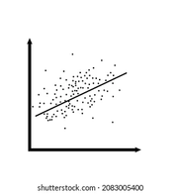

DELIVERABLES
Geographic Heatmap and Regional Analysis
Stepwise Regression Results
Simple Linear Regression Analysis
Correlation Heatmap

Slide 8

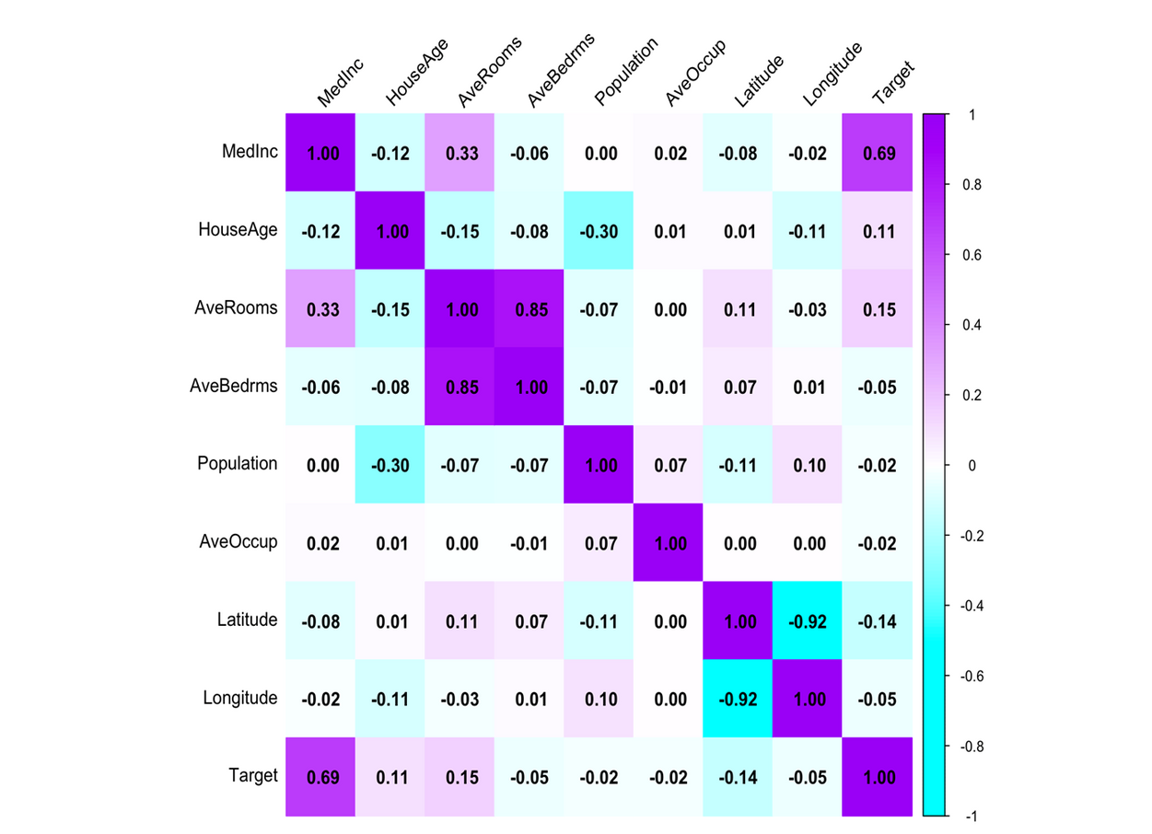
Correlation Analysis

Slide 9

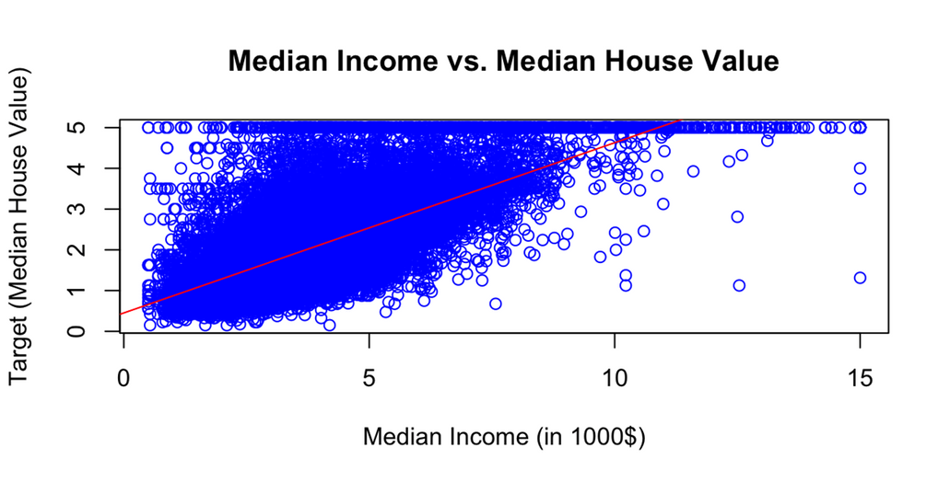
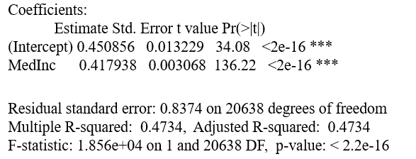
SIMPLE LINEAR REGRESSION: MEDIAN INCOME VS. HOUSING PRICE

Slide 10
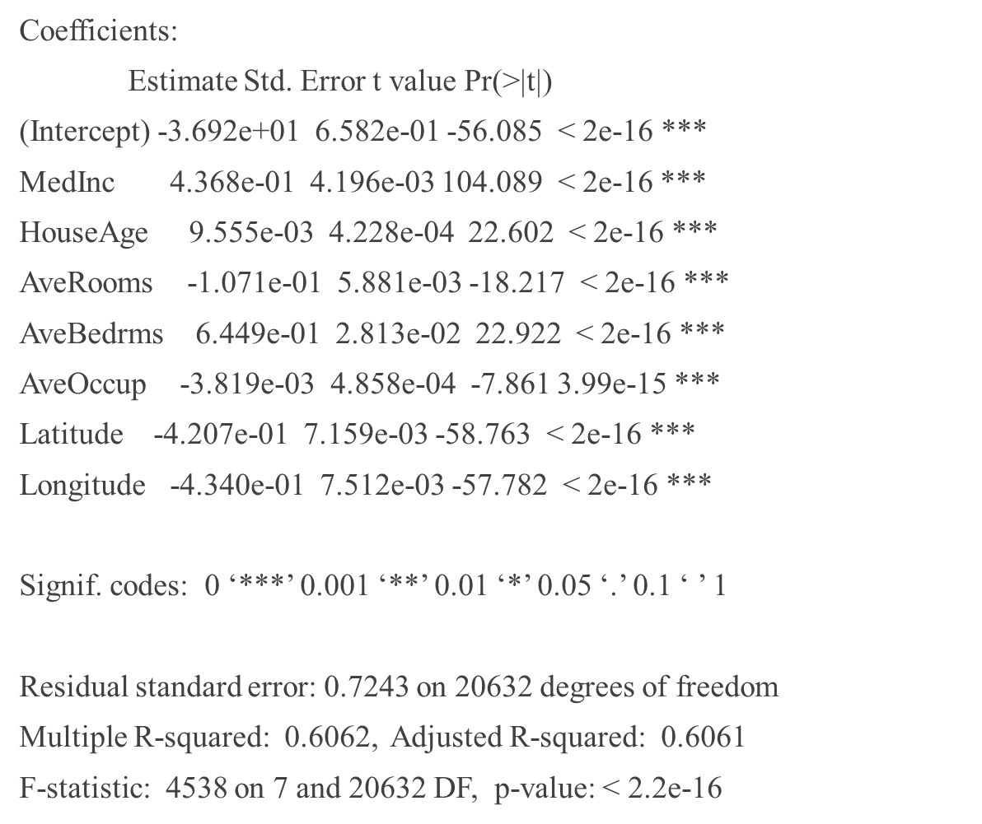
MULTIPLE LINEAR REGRESSION WITH SUBSET SELECTION

Slide 11
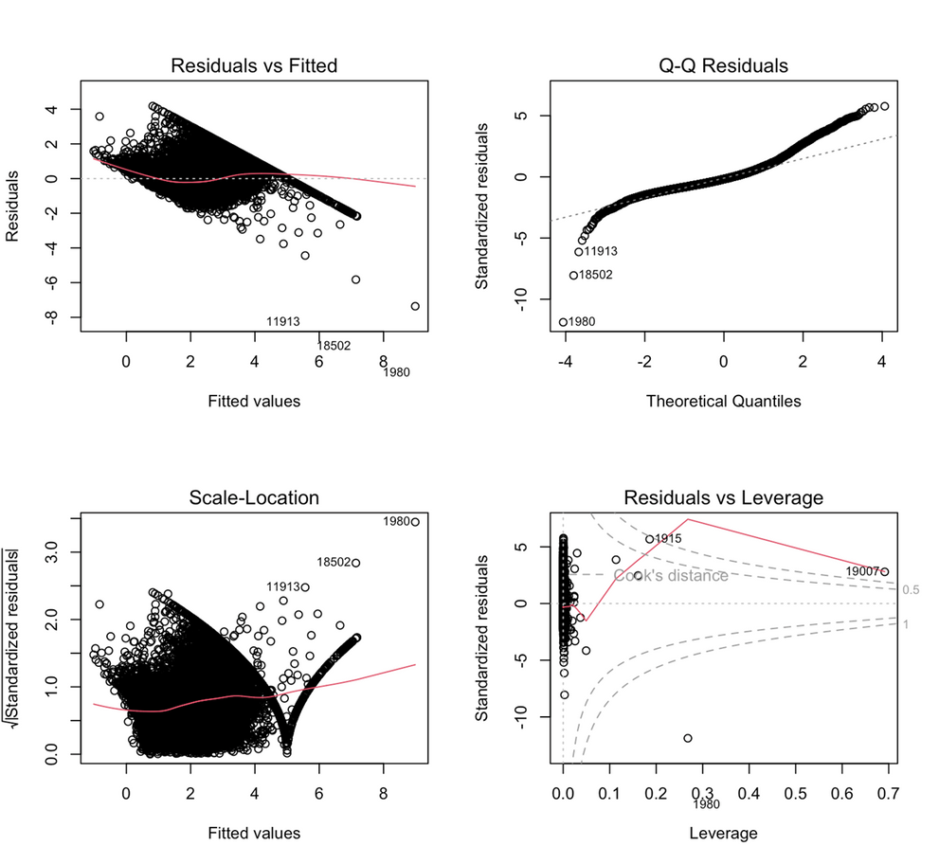
RESIDUAL ANALYSIS OF MULTIPLE LINEAR REGRESSION

Slide 12

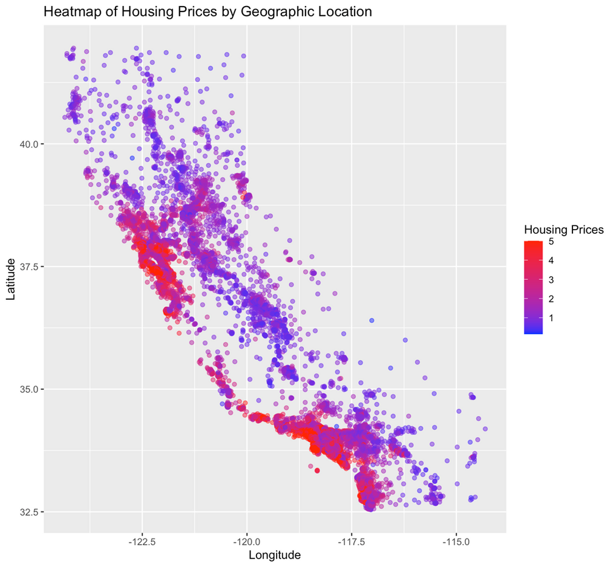
GEOGRAPHIC HEATMAP AND REGIONAL ANALYSIS

Slide 13



KEY TAKEAWAYS AND NEXT STEPS
Key Findings
Future Directions
Collaboration

Slide 14






THANK YOU

